Slide 1
Technical Orientation
Center for Innovative Learning
12 January 2026

Slide 2
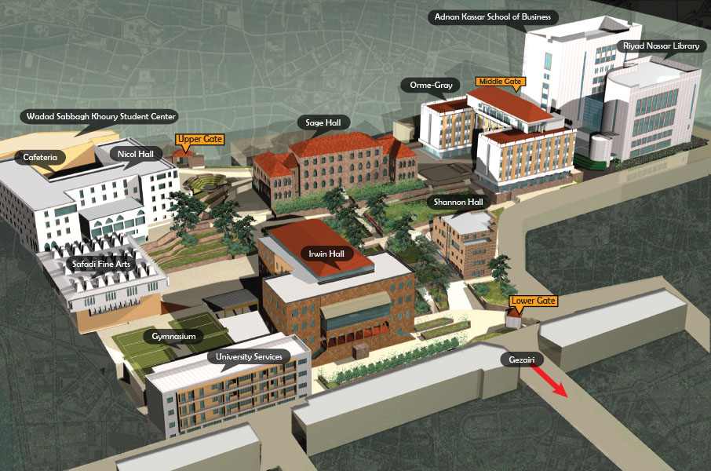
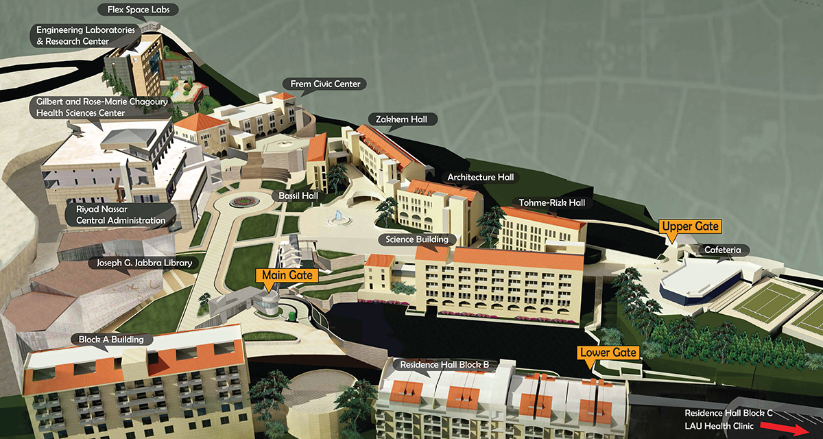
Where is the Center for Innovative Learning?
https://cil.lau.edu.lb/
Beirut Campus: Riyad Nassar Library, Room 708 (access through elevator next to the Circulation Desk)
  https://lb.linkedin.com/in/center-for-innovative-learning-lau-19a385253
  Byblos Campus: Residence Hall building Block B

Slide 3
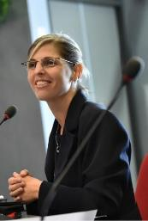
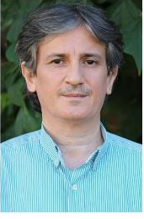
The Smiling Faces of the CIL
Dr. Jordan Srour
Mr. Alex Joulhajian
Go to For:
Faculty Teaching Questions
Help identifying resources in the broader LAU landscape
An enthusiastic response to all your ideas
Go to For:
Orientation questions
Faculty Fellows Program questions
Teaching IT questions
That good feeling that things will get done

Slide 4

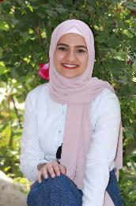
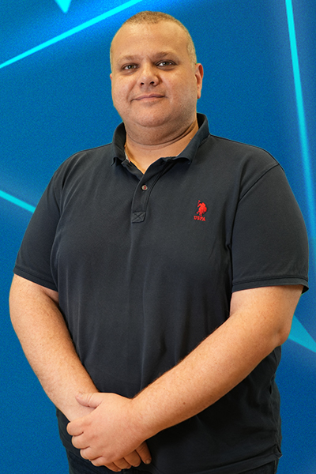
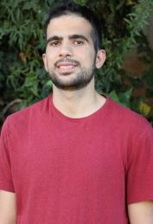

The Smiling Faces of the CIL
Instructional Design and Technology Super Heroes
Multi-Media Gurus
Ms. Sara Hassoun
Ms. Douaa Zaidan
Mr. Bilal Hanbali
Mr. Ricardo El Khoury
Mr. Issa Al Khanji
Go to For:
Well-written learning outcomes
Syllabi reviews and great ideas for pedagogical strategies – both in-person and online
Go to For:
EdTech Enabled interactive courses
Support with Blackboard designs
Inspirational use of AI to make everything in life easier
Go to For:
Custom builds of your wildest classroom tech dreams…XR, AI, and more…
Go to For:
Great design ideas
Media support
Fun days of filming
Insights on how that one scene in your favorite movie was actually made…
Go to For:
Great design ideas
Media support
Fun days of filming
A terrific team spirit vibe

Slide 5
EDMS Form Requests!!
https://edms.lau.edu.lb/Forms/Uyq8t

Slide 6
Key Tools
Banner
Starfish
Blackboard
For Class, Student Management
For Delivering Material
https://myportal.lau.edu.lb

Slide 7
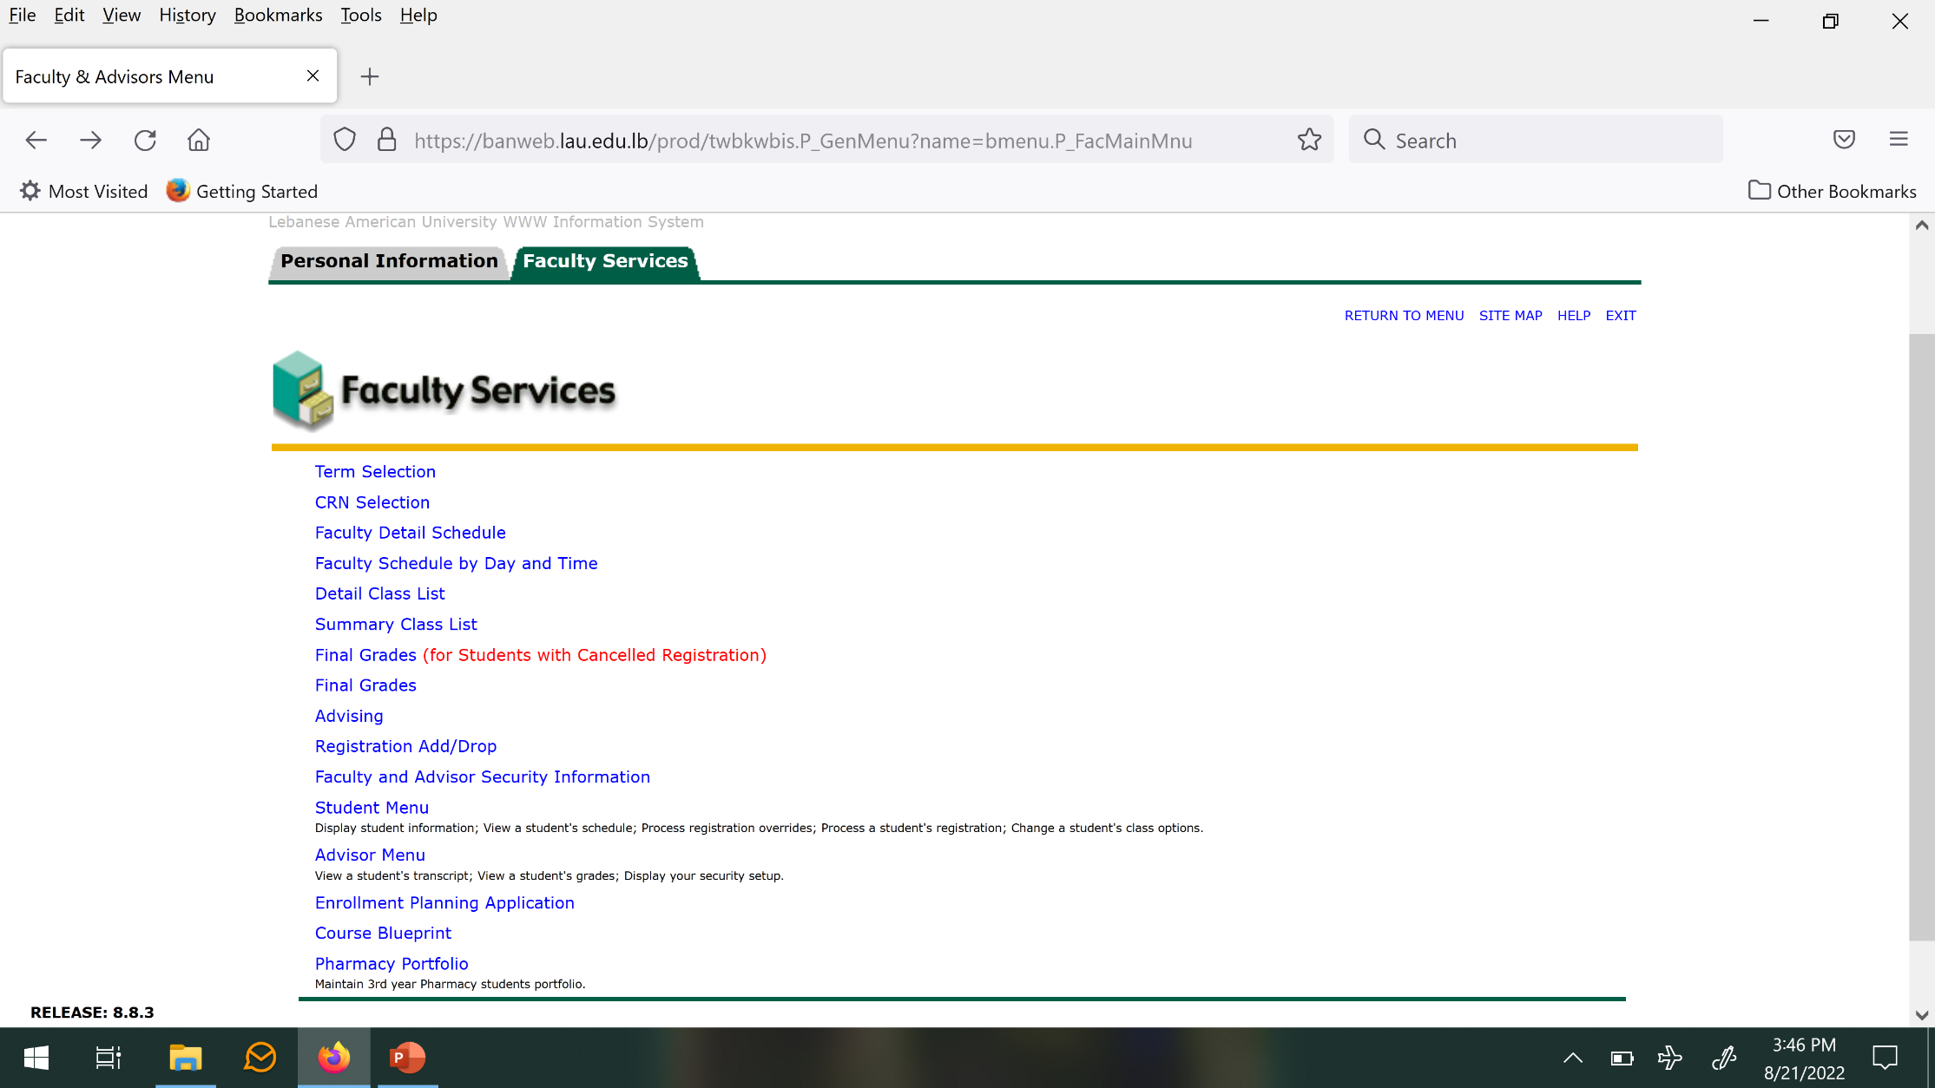
Banner
https://banweb.lau.edu.lb
Used for:
Checking class schedule
Checking number of students enrolled
Emailing students
Entering final scores
Advising

Slide 8
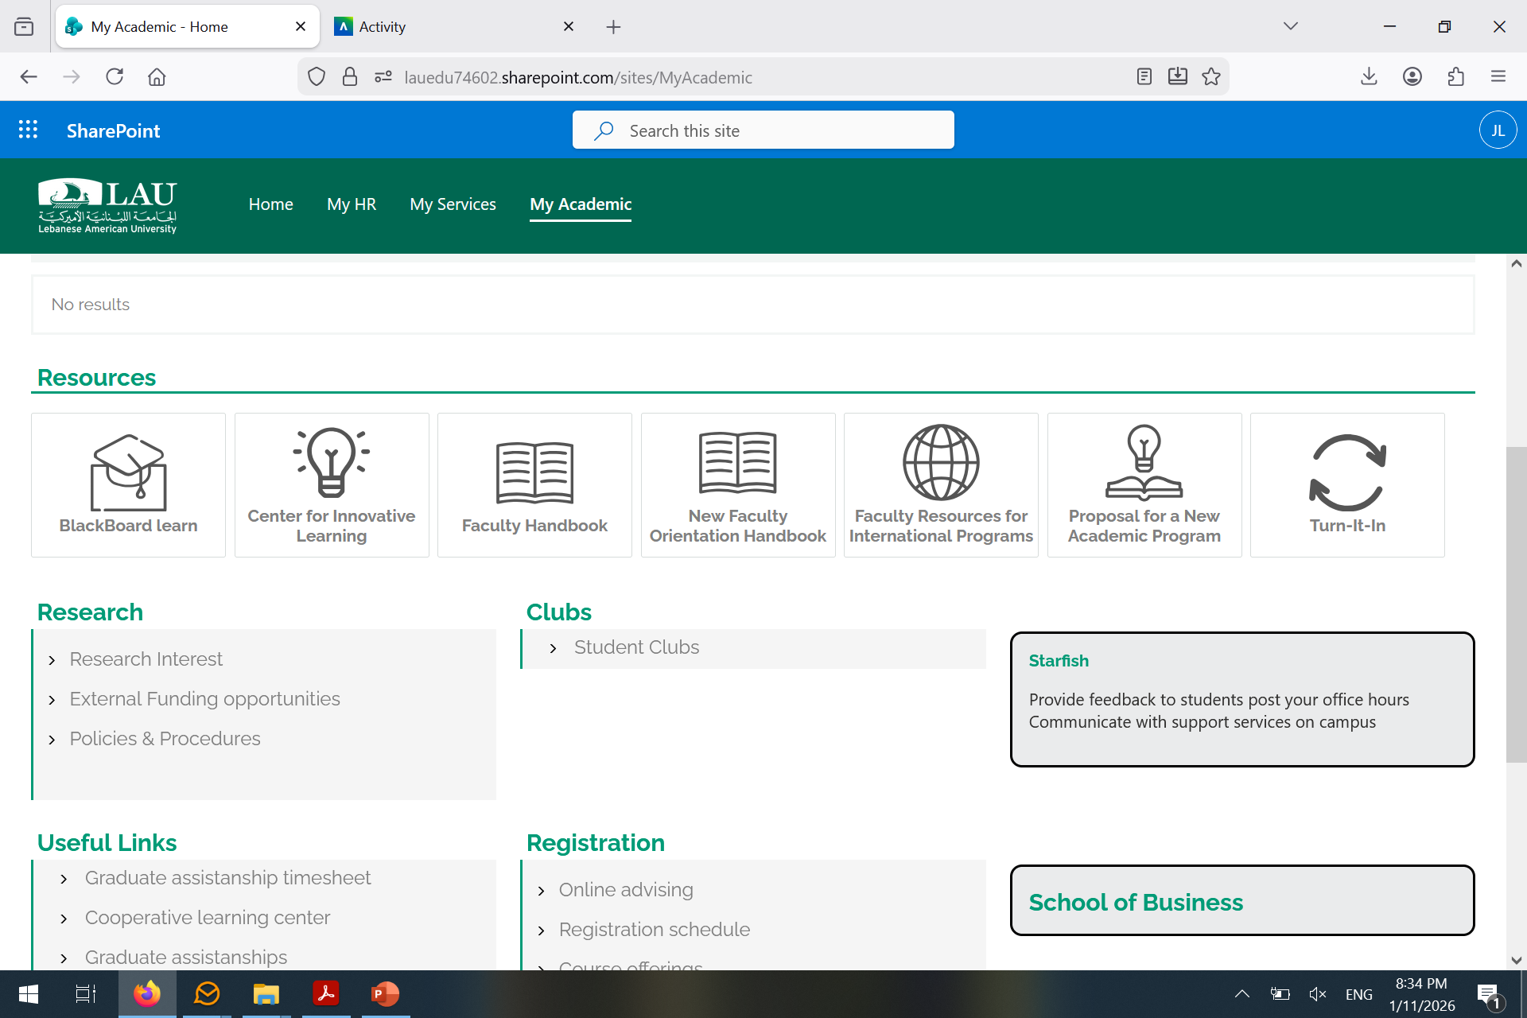
Starfish
https://myportal.lau.edu.lb
Used for:
Printing photo rosters
Checking student schedules
Flagging student issues

Slide 9
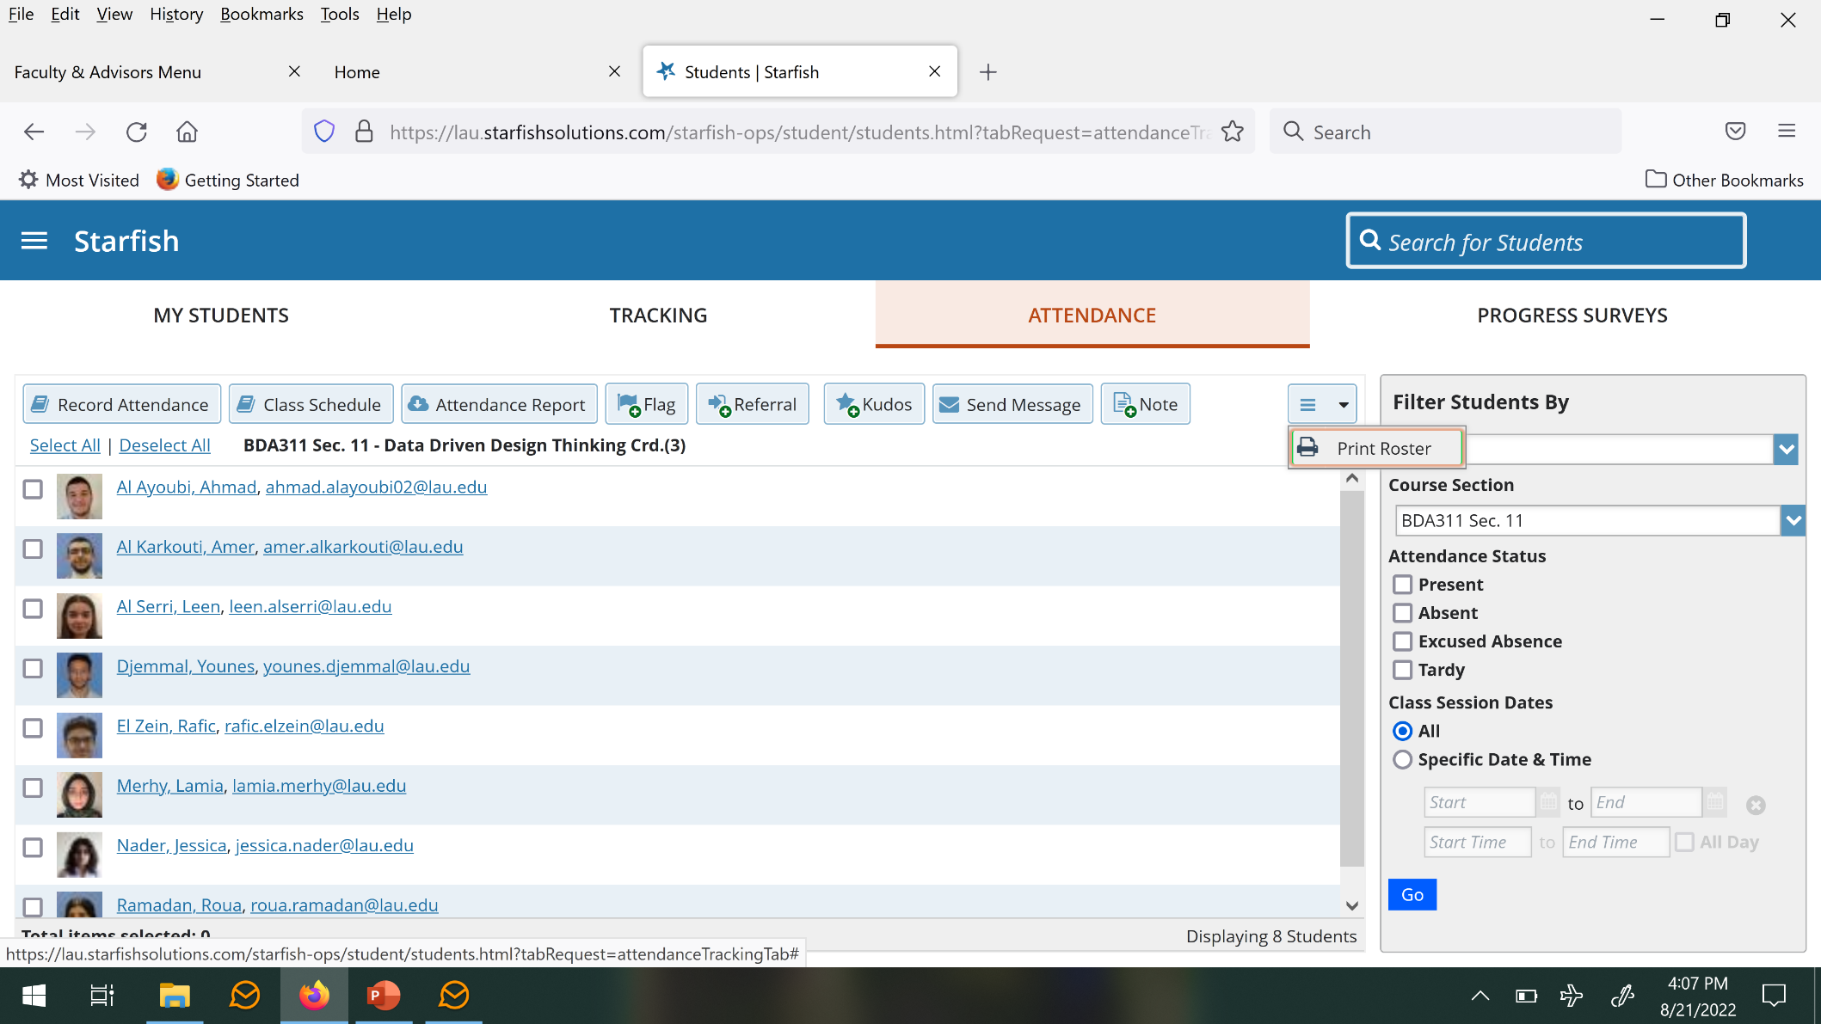
Starfish

Slide 10
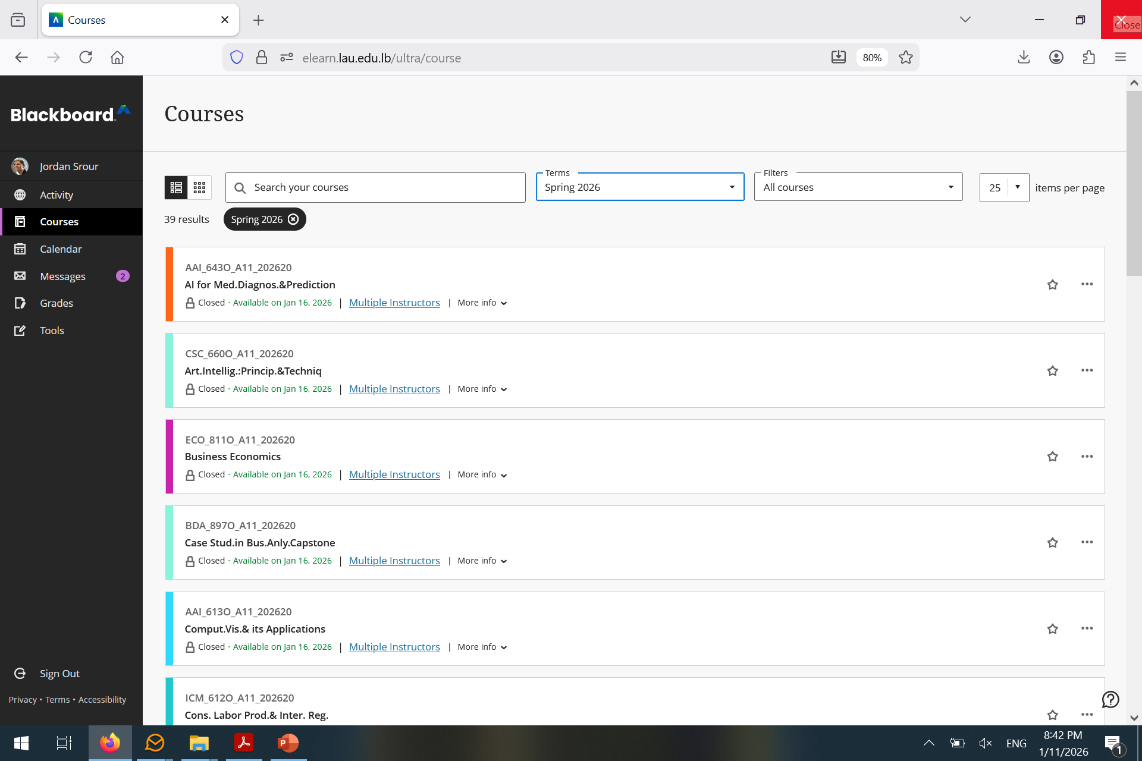
Blackboard
https://elearn.lau.edu.lb/
Used for:
Providing course content for students
At a minimum, must post syllabus on BB
Need Help? https://cil.lau.edu.lb/resources/online-learning.php

