Slide 1
Teaching Policies and Culture Orientation Center for Innovative Learning
13 January 2026

Slide 2
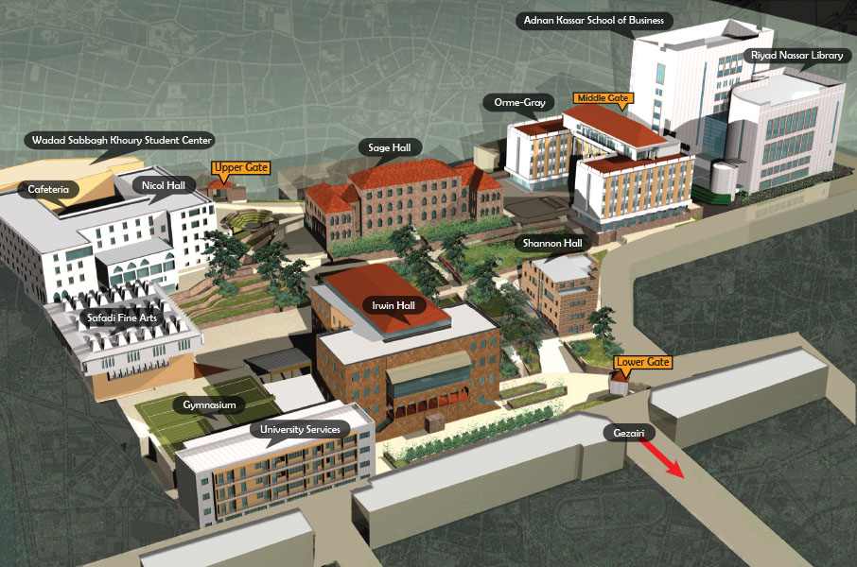
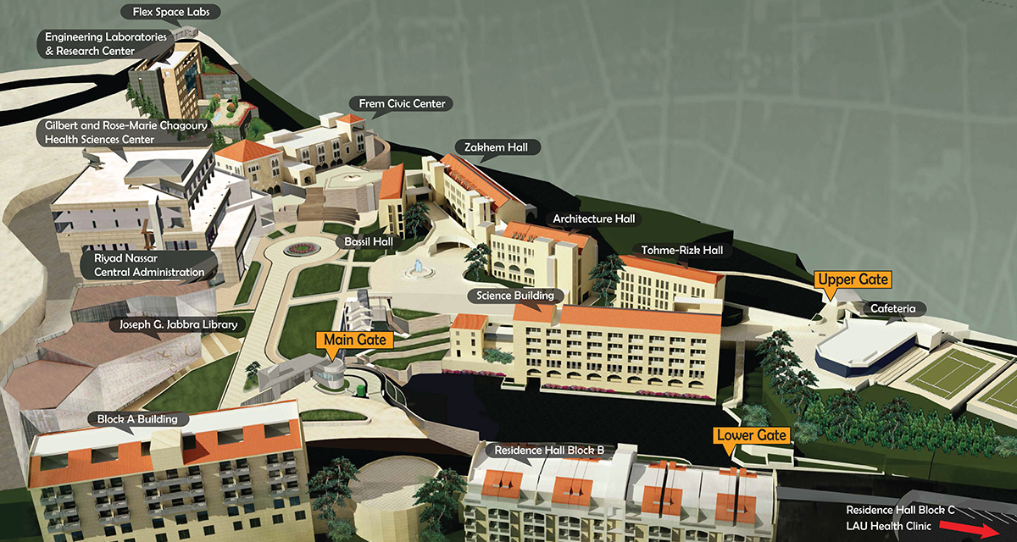
Where is the Center for Innovative Learning?
https://cil.lau.edu.lb/
Beirut Campus: Riyad Nassar Library, Room 708 (access through elevator next to the Circulation Desk)
https://lb.linkedin.com/in/center-for-innovative-learning-lau-19a385253
Byblos Campus: Residence Hall building Block B

Slide 3

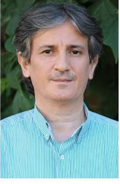
The Smiling Faces of the CIL
Dr. Jordan Srour
Mr. Alex Joulhajian
Go to For:
Faculty Teaching Questions
Help identifying resources in the broader LAU landscape
An enthusiastic response to all your ideas
Go to For:
Orientation questions
Faculty Fellows Program questions
Teaching IT questions
That good feeling that things will get done

Slide 4


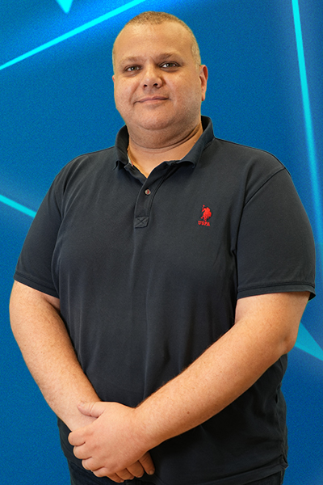


The Smiling Faces of the CIL
Instructional Design and Technology Super Heros
Multi-Media Gurus
Ms. Sara Hassoun
Ms. Douaa Zaidan
Mr. Bilal Hanbali
Mr. Ricardo El Khoury
Mr. Issa Al Khanji
Go to For:
Well-written learning outcomes
Syllabi reviews and great ideas for pedagogical strategies – both in-person and online
Go to For:
EdTech Enabled interactive courses
Support with Blackboard designs
Inspirational use of AI to make everything in life easier
Go to For:
Custom builds of your wildest classroom tech dreams…XR, AI, and more…
Go to For:
Great design ideas
Media support
Fun days of filming
Insights on how that one scene in your favorite movie was actually made…
Go to For:
Great design ideas
Media support
Fun days of filming
A terrific team spirit vibe

Slide 5
EDMS Form Requests!!
https://edms.lau.edu.lb/Forms/Uyq8t

Slide 6


Slide 7
Purpose
A record of the course
A contract between the student and faculty
A learning tool

Slide 8
Key Elements of a Syllabus
Class Info – Date/Time, Instructor Contact, Office Hours
Learning Outcomes
Course Content – Required Reading, Schedule, etc
Policies
Grading (note: cannot include a grade for attendance)
Attendance
AI
Conduct & Ethics

Slide 9
Learning Outcomes

Slide 10
Course Goals
How would you like your students to be different/changed after completing this course?
Assessment
How will you be able to capture/measure the change in your students?
Learning Outcomes
What must your students be able to think/do to succeed in the assessment?
Tools
What online tools are best suited to give the student the needed experiences?
What learning experiences must the student have to achieve the learning outcome?

Slide 11
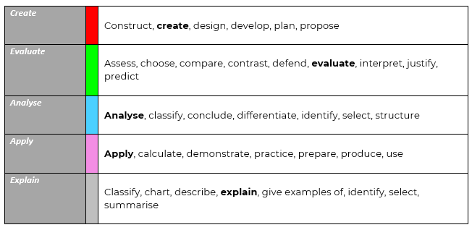
Learning Outcomes

Slide 12
Course Content

Slide 13
CIL
Instructional Design Consultation
Ms. Sara Hassoun, sara.hassoun01@lau.edu.lb
https://cil.lau.edu.lb

Slide 14
LAU Libraries
Course Pack Review
Mr. Ibrahim Farah, Ibrahim.farah01@lau.edu.lb
https://libraries.lau.edu.lb

Slide 15
Grading
Final examinations are held at the end of each semester and summer term. Final examinations should not count for more than 40 percent of the course grade and should be clearly stated in course syllabuses. At least two tests and/or graded projects should account for the remaining percentage of the course grade.
Your Control v. Student Control
Group v. Individual
In-class v. At home
For doing work v. Demonstrating knowledge
Grade | Quality Points | Guidelines over 100
A | 4 | ≥ 90
A⁻ | 3.67 | 87 - 89
B⁺ | 3.33 | 83 - 86
B | 3.0 | 80 - 82
B⁻ | 2.67 | 77 - 79
C⁺ | 2.33 | 73 - 76
C | 2 | 70 - 72
C⁻ | 1.67 | 67 - 69
D⁺ | 1.33 | 63 - 66
D | 1 | 60 -62
F | 0 | ≤ 59

Slide 16
Policies

Slide 17
Conduct and Ethics
Office of Professionalism and Ethics
Dr. Emily Gafney, OPE@lau.edu.lb
https://ope.lau.edu.lb/
https://www.lau.edu.lb/about/policies/student_code_of_conduct.pdf
https://catalog.lau.edu.lb/2025-2026/undergraduate/academic-rules-procedures.php

Slide 18
AI, https://cil.lau.edu.lb/ai-in-education/
Faculty should clearly communicate the level of generative AI use allowed in their course through the course syllabus.
In the absence of any specific course/program policy on the syllabus, then the following sections from the student code of conduct applies:
2.2.1. Using material or equipment (including mobile phones, smart watches, electronic tablets, i-pads, calculators, and assistive tools such as AI generated content) that is not authorized or consented by the instructor in an examination, project, or graded assignment.
2.2.2. Cheating, copying, collaborating with, or aiding another Student in a manner not permitted by the instructor on an examination, project, or other graded assignment. If a student, graduate or undergraduate, requires additional assistance on any assignment, beyond what LAU provides (including but not limited to: the instructor’s help during office hours, the tutoring sessions of the University’s Academic Success Center, and/or the help of the University’s Writing Center), the student must notify the class instructor and get his/her approval to do so. The student must specify the name of the help provider (be it a peer LAU student, a friend, a parent, a sibling, an alumna (us), external outsourcing, etc.), in addition to the nature and the scope of the assistance that will be provided.
https://www.lau.edu.lb/about/policies/student_code_of_conduct.pdf

Slide 19
LAU instructors may have different rules and expectations for using generative AI (generative AI) tools. Should one instructor approve the use of generative AI, this does not mean it will be permitted by others.
In this course, students will be allowed to use generative AI for specific course tasks and only after receiving prior approval from the instructor. It is important to note that any approved AI assistance should prioritize your individual learning and critical thinking skills. You are strongly encouraged to primarily rely on your knowledge, research, and problem-solving abilities to complete assignments.
If you choose to utilize AI tools or resources, ensure that you clearly follow the allowed usage level in previously approved assignments:
Course Assignment | AI Usage Allowed
Tests/Quizzes/Exams | None: No AI usage allowed
Class Discussion | Low: Brainstorming (critical thinking)
Presentation | Medium: summary/synthesis (research)
Formal Debate | High: idea development/insights (critical thinking)
Research Paper | Low: Spell/Grammar check (writing); information/resource gathering (research)
https://cil.lau.edu.lb/images/AI%20Guidance%20-%20Teaching%20and%20Learning_Jan2026.pdf

Slide 20
Attendance
Students are held responsible for all the material presented in the classroom or during synchronous online sessions, even during their absence.
Students can miss no more than two weeks of classes in any semester excused and otherwise, in any course, and still receive credit for that course.
Instructors will inform their departments and the Office of the Dean of Students of any prolonged, unexplained absence of a given student.
Students who exceed the allowed number of absences must withdraw from the course; otherwise, the course grade will be recorded by the instructor as F or NP, depending on the type of grading in the particular course.
In highly exceptional cases, students may be given special permission by the Academic School Councils to continue in the course.

